Slide 1
Bubble & Quick sort, Linear Search & Binary Search
Team 3

Slide 2
Bubble Sort
Bubble Sort is the simplest sorting algorithm.
It works by repeatedly swapping the adjacent elements if they are in the wrong order.
This algorithm is not suitable for large data sets as its average.
It has a time complexity of O(N²) and a space complexity of O(1) since it does not require any additional memory space apart from a temporary variable used for swapping. ( Time is more and space is less)
Advantages of Bubble Sort:
Bubble sort is easy to understand and implement.
It does not require any additional memory space.
It is a stable sorting algorithm, meaning that elements with the same key value maintain their relative order in the sorted output.

Slide 3
Time Complexity Analysis of Bubble Sort:
Best Case: The best case occurs when the array is already sorted. So, the number of comparisons required is N-1 and the number of swaps required = 0. Hence the best-case complexity is O(N).
Worst Case: The worst-case condition for bubble sort occurs when elements of the array are arranged in decreasing order. In the worst case, the total number of iterations or passes required to sort a given array is (N-1). where ‘N’ is the number of elements present in the array.

Slide 4
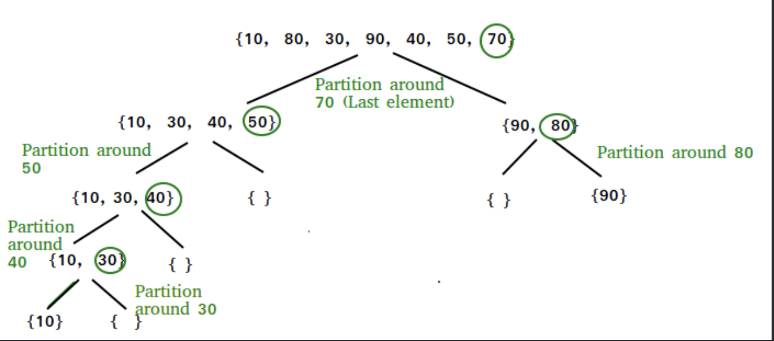
Quick Sort
Quick Sort is a sorting algorithm based on the divide and conquer algorithms.
The key process in quickSort is a partition(). The target of partitions is to place the pivot (any element can be chosen to be a pivot) at its correct position in the sorted array and put all smaller elements to the left of the pivot, and all greater elements to the right of the pivot.

Slide 5
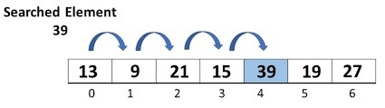
Linear Search
A linear search is the simplest approach employed to search for an element in a data set.
It examines each element until it finds a match, starting at the beginning of the data set, until the end.
The search is finished and terminated once the target element is located.

Slide 6
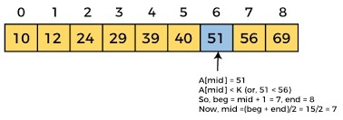
Binary Search
Binary search is an efficient algorithm for finding an item from a sorted list of items. It works by repeatedly dividing in half the portion of the list that could contain the item, until you've narrowed down the possible locations to just one. We used binary search in the guessing game in the introductory tutorial.

